Slide 1

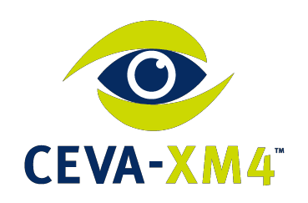

The Path to Embedded Vision & AI using a Low Power Vision DSP
Yair Siegel, Director of Segment Marketing Hotchips – August 2016

Slide 2

Presentation Outline
Introduction
The Need for Embedded Vision & AI
Vision Processor
Deep Learning Path to Low Power AI Devices
Summary

Slide 3



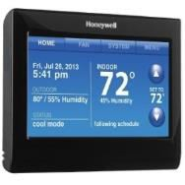

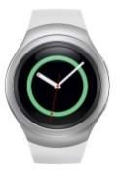


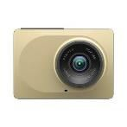
CEVA – Licensor of ultra-low-power signal
processing IP’s for embedded devices
Imaging & Vision
Audio, Voice, Sensing
Connectivity Communication
>7 Billion CEVA-powered devices shipped world-wide

Slide 4
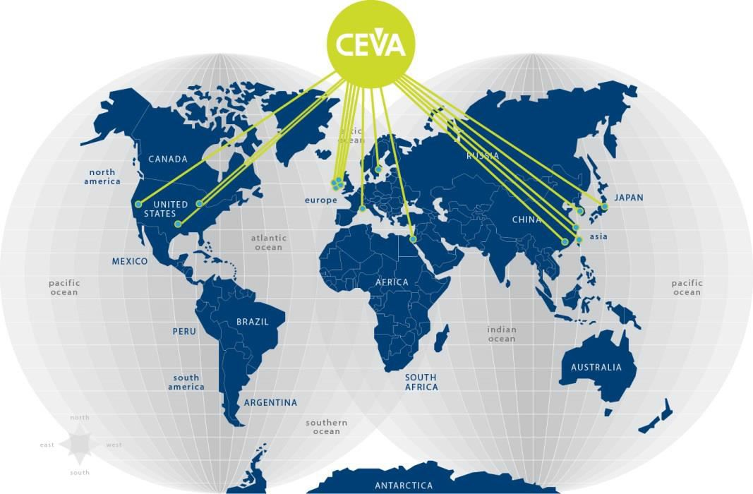
Corporate Introduction
Corporate Facts
Worldwide Operations
Headquartered in Mountain View, Calif.
Publicly traded - NASDAQ:CEVA
273 employees, >200 eng.
Profitable, cash positive,
>$138M cash
World Leading IP Supplier
since 1991
US (Mountain View, CA, Austin, TX & Detroit, MI), Israel, Ireland, France, U.K, Sweden, China, Taiwan, Korea & Japan

Slide 5



















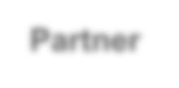









CEVA Value Chain
IDM
Cooperation with Foundries and Design Service Companies
Chips
OEM
Silicon IP
CEVA
Development Tools
Support, SW
Cooperation
Partner
Solutions (HW + SW + Services)
Providing hardware, software, tools and support from license to deployment!

Slide 6
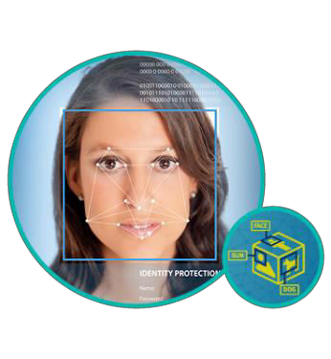

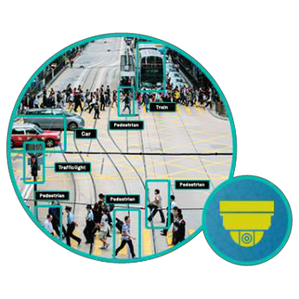
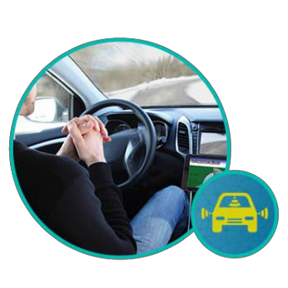

The Need for Embedded Vision & AI
Security & Surveillance
Visual Perception & Analytics
ADAS & Autonomous Cars
Augmented Reality
Drones

Slide 7

CEVA-XM4 Vision DSP Highlights
1.5GHz max frequency @28nm HPM
14 stage deep pipeline
128 MACs, 8-way VLIW, 4096-bit vector engine 32-way parallel random memory access
Enables serial code vectorization
Sliding window & sliding pattern mechanisms
Efficient 2-dimension data processing
Silicon proven, 15+ design wins for variety of
products
Completed ISO 26262 compliance & process
certification

Slide 8
CEVA-XM4 Performance Highlights
Fixed- and floating-point math
Available both in vector and scalar structures
8/16/32/64-bit fixed point precision
Native non linear operations in single cycle
 | Multipliers per cycle
Scalar fixed-point | 4
Scalar Floating-point | 4
Vector fixed-point | 128
Vector Floating-point | 16
1,
𝑥, ⁻¹ 𝑥
𝑥
Supported both in fixed and float operations Multiple 128 or 256-bit AXI interfaces Extendible ISA
High Performance, yet flexible in precision and operation

Slide 9
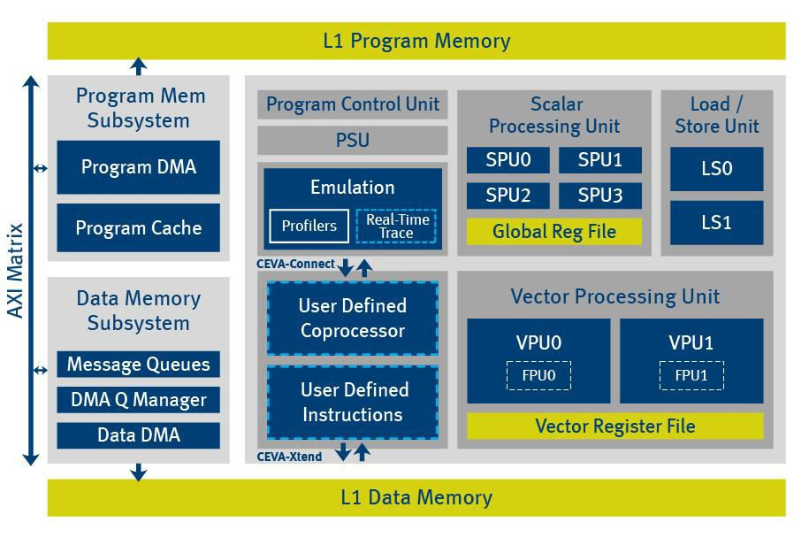
CEVA-XM4 Block Diagram
Parallel Random Mem Access
Scalar Floating-Point
4-Way I-Cache
128 MACs
Multi-Core
Interfaces
Vector Floating-Point
Automatic management of HW accelerators
Specialized DMA
CEVA-Xtend User Instructions (Vector & Scalar)
CEVA-Connect Customer HW accelerators

Slide 10




CEVA Vision Platform Layers
CEVA Software Products
Partner Software Products
Face Detection & Recognition
Universal Object Recognition
Pedestrian Detection
ADAS Algorithms (FCW, LDW)
3D Depth Map Creation
Software Layer
Digital Video Stabilizer (DVS)
Super-Resolution (SR)
SW
Toolset
CPU
Provides OEM
Host CEVA-CV API / OpenVX
offload CEVA-CV Libraries
differentiation
App Dev.
Kit (ADK)
RTOS
CEVA CNN Framework (CDNN)
CPU-DSP Link – Communication Layer
Hardware Development Kit
Hardware Layer
CEVA-XM4 DSP Core
*available for XM4 only
CEVA Inc. All rights reserved
10

Slide 11
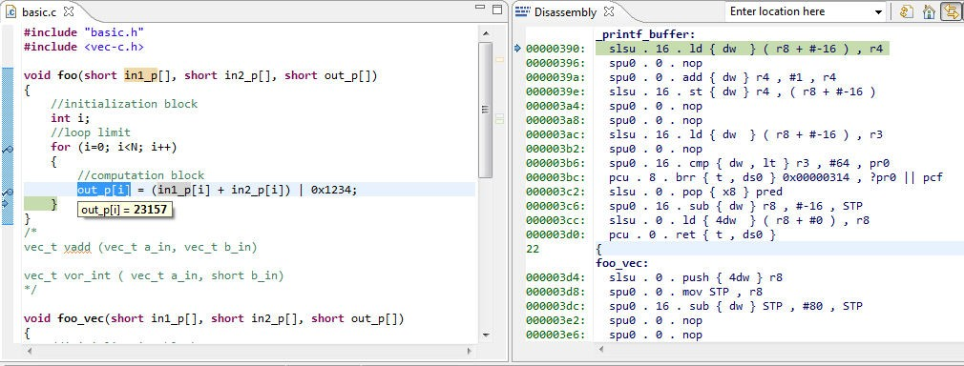

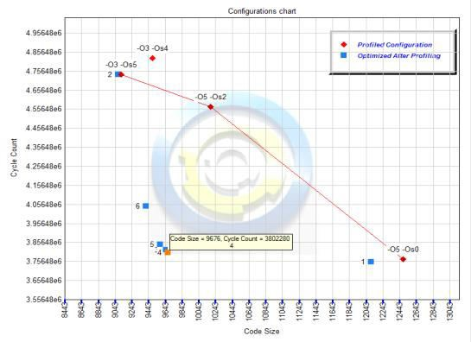

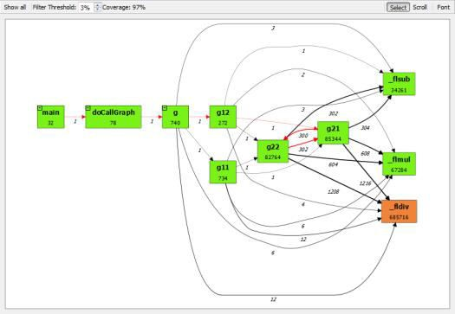
CEVA-ToolBox™ - Eclipse based SW Dev. Tools
Advanced Eclipse-based IDE
Optimizing C/C++ tailored compiler
Auto vectorization Extensive Vec-C support
C language extensions in OpenCL-like syntax
Vector types for C/C++ - short8, ushort32,…
Vectorization from operators
Linker and Utilities Automatic Build Optimizer
CEVA-Xtend GUI Instruction builder Built-in Debugger, Simulator & Profiler
Target Emulation dev. kit
IDE / Debugger
View
Build Optimizer
Profiler –
Function Graph
Complete Software Development tools.
Focused on ease of use and quick SW porting for performance optimization

Slide 12






















































Parallel Random Memory Access Mechanism
CEVA-XM4 scatter-gather capability enables load/store vector elements from/into multiple memory locations in a single cycle
Enables serial code vectorization
Able to load values from 32 addresses per cycle
b7 | b6 | b5 | b4 | b3 | b2 | b1 | b0
Vector Register
Example: Image histogram requires random accesses to memory per pixel
Each “value” (within a vector) can generate an
address that allows it to vectorize/parallel the
L1 Memory
operations into a multiple operation within a single cycle

Slide 13

Histogram Power Analysis
Using Special Histogram HW Support
CEVA-XM4 Power Consumption per Block Running Histogram
Others
DMEM
DMSS
Without Histogram Special HW Support (convential DSP / CPU Approach)
PMEM
PMSS
Core
Special histogram HW consumes 1.89x higher power per cycle,
but kernel is 100x faster ➔ ~50x better power efficiency for entire calculation!

Slide 14
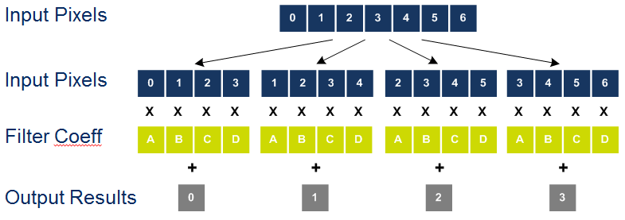
Sliding-Window Data Processing Mechanism
CEVA-XM4 processes 2D data efficiently
Takes advantage of pixel overlap in image processing by reusing same data to produce multiple outputs
Significantly increases processing capability
Saves external memory bandwidth and frees system buses for other tasks Reduces power consumption
 | Reuse
Input Image
For 16 MAC with 512-bit bandwidth, only 176 bits actually loaded

Slide 15
Input Data Reuse Example
The vector instruction performs the arithmetic operation multiple times in parallel (producing multiple results). The next sliding-window operation is offset by a step from the previous operation.
Input Data Vector A Input Data Vector B
5 6 7 7 8 9 10 10 11 12 13 14 15
5
6
6
7
8
5
6
6
7
8
7
9
1
8
9
1
2
2
3
3
4
3
3 4
4
5
5
0 0 1 2 2 3 4 4
X | X |  | X | X | X | X |  | X | X | X | X |  | X | X | X | X |  | X | X
A | B |  | C | D | A | B |  | C | D | A | B |  | C | D | A | B |  | C | D
 |  | + |  |  |  |  | + |  |  |  |  | + |  |  |  |  | +
 |  | 0 |  |  |  |  | 1 |  |  |  |  | 2 |  |  |  |  | 3

Slide 16
Sliding-Window Pattern Mechanism
Sliding-window pattern (i.e. sliding pattern) efficiently handles sparse
filters
Sparse filters are defined as filters that contain some coefficients equal to zero
Instead of multiplying the input data by zero, the sliding pattern skips
zero coefficients and improves efficiency (and keeps power low)

Slide 17
Sliding-Window Pattern Example
Example below describes a sparse filter
~45% non-zero coefficients
Achieves 92% multiplier utilization, completing filter in 3 cycles
“Standard” implementation: ~55% multiplier utilization in 5 cycles
Sparse Filter Sliding Pattern Sliding Window
0 0 0
0
0
0
0 0 0

Slide 18
Sliding-Window Pattern Power Savings
Relative Power Consumption
 | Sliding Window Utilization | Sliding Pattern Utilization
Convolution 5x5 | 62.5% | 89%
Sobel 3x3 | 75% | 75%
Average 7x7 | 87.5% | 94%
CEVA-XM4 "Sliding Window" CEVA-XM4 "Sliding Pattern"
Convolution 5x5
Sobel 3x3
Average 7x7

Slide 19
Sliding Window, Sliding Pattern Power Savings
Relative Power Consumption
90x 80x 70x
60x
50x 40x 30x
20x 10x
CPU GPU
CEVA-XM4 Scalar Only CEVA-XM4 "Sliding Window"
Convolution
Sobel 3x3
Average 7x7
CEVA-XM4 "Sliding Pattern"
5x5
CEVA Inc. All rights reserved

Slide 20

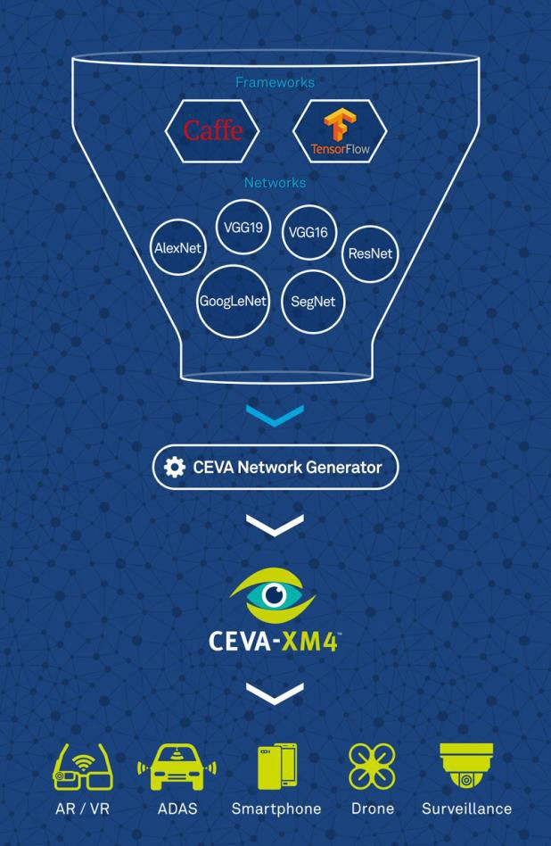

CEVA Deep Neural Network (CDNN2)
2nd gen SW framework support Caffe and TensorFlow Frameworks Various networks*
All network topologies All the leading layers Variable ROI
“Push-button” conversion from pre-trained networks to optimized real-time
Accelerates machine learning deployment for embedded systems
Optimized for CEVA-XM4 vision DSP
(*) Including AlexNet, GoogLeNet, ResNet, SegNet, VGG, NIN and others

Slide 21


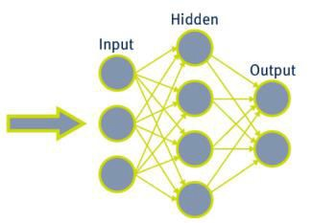
CEVA Network Generator
Image Database
(For Training)
Pre-Trained Network
(Deploy.caffemodel)
Caffe
TensorFlow
Network Structure (Deploy.prototxt)
Normalization Image (Deploy.binaryproto)
Network Labeling (Deploy.labels)
CEVA
Network
Generator
CEVA-XM4
Optimized Network

Slide 22
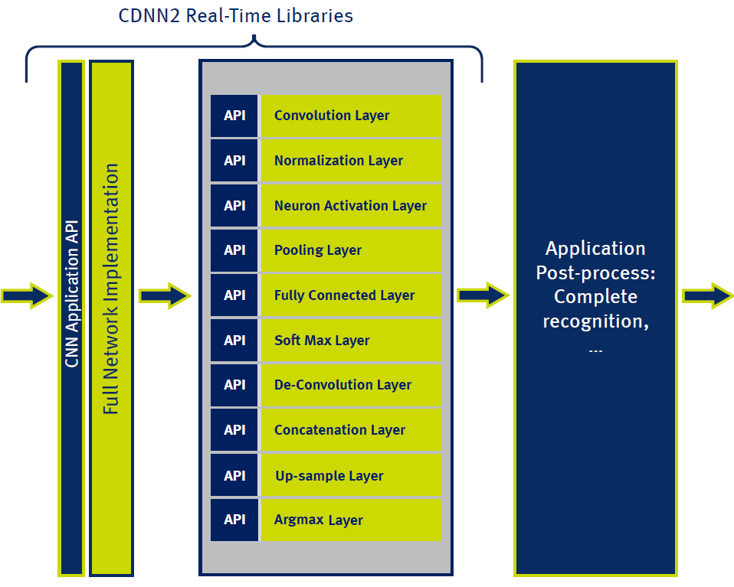






Real-Time CDNN2 Application Flow
Input Image
ROI
“Horse”

Slide 23

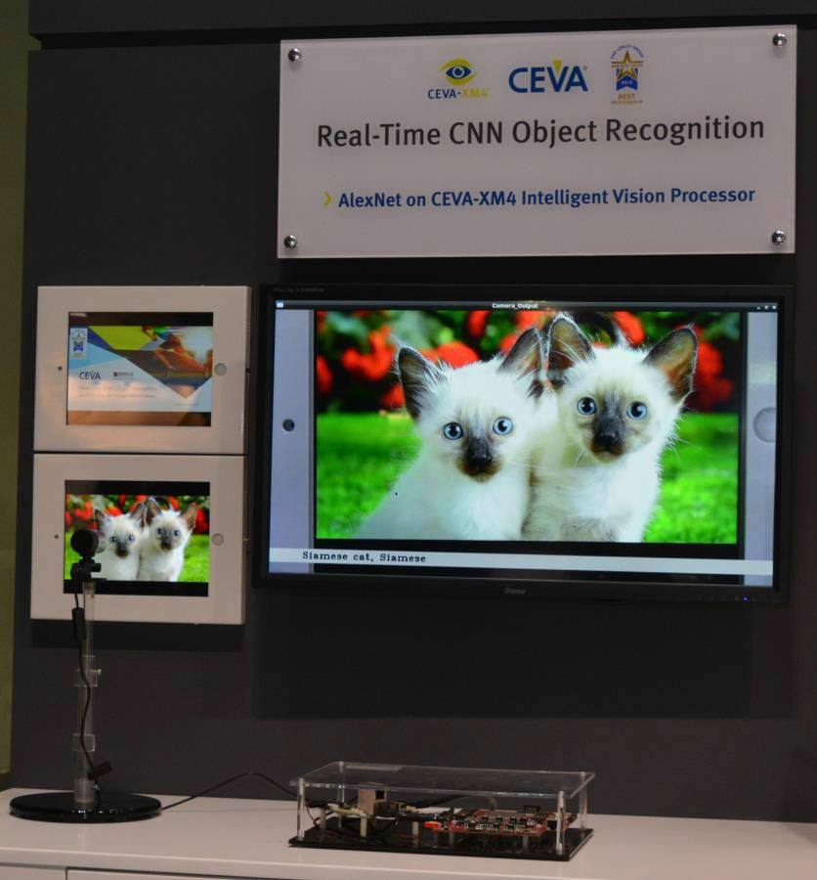
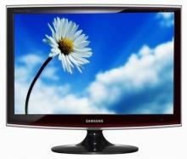


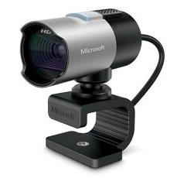
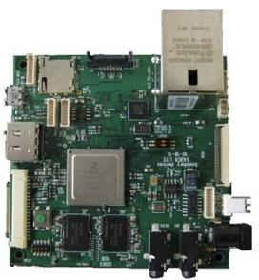
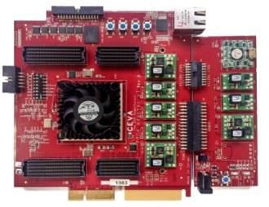
Real-Time CNN Object Recognition Demo
Live Alexnet object recognition
Enables milli-watt products vs. watts on GPU
Daisy
Live CDNN2 demo
Convert network in under 10min!
Input Images
HDMI
Webcam FHD
PCIe
i.MX6
XM4 FPGA

Slide 24

Vision & Deep Learning SoC Example
Vision SoC
Typical SoC for recording devices such as action / dash / surveillance cameras
Enables OEM differentiation by adding highest-end camera features
Ultra low power: Full vision system below 1w@28nm
A X I
Encoder HW
ISP HW
Sensor I/F (MIPI)
I/F (USB)
 | CPU @ 1GHz
 | CEVA-XM4 @ 800 MHz
DDR
Cont.

Slide 25
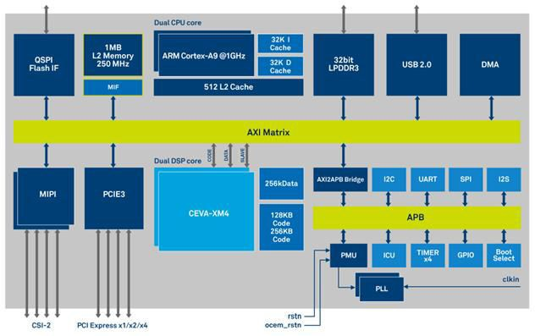
Brite Semi Vision & Deep Learning SoC
High-end vision system,
Available Early 2017

Slide 26
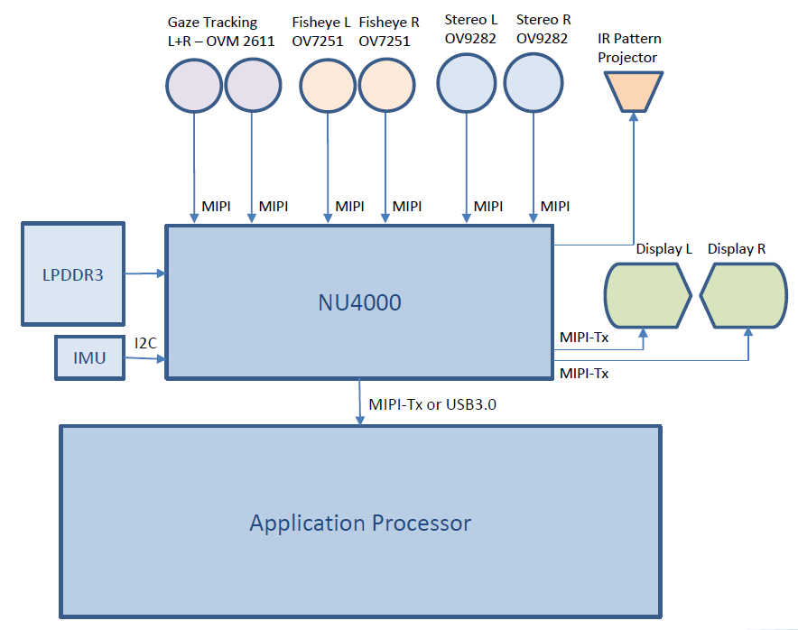

AR/VR Ref System Example using Inuitive NU4000
High-end AR/VR system supporting depth sensing, deep learning, SLAM and vision, but cutting power by a factor
CEVA-XM4
Vision Processor

Slide 27
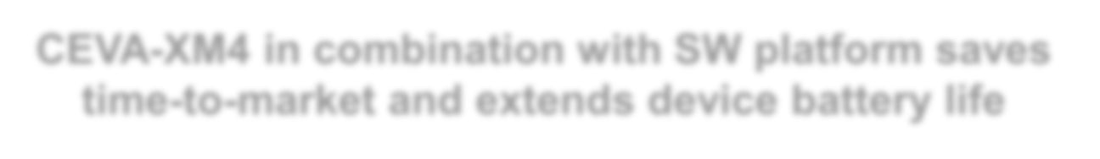

Why DSP Is Better as Vision Processor?
Domain-specific architecture – focused on computer vision
Dedicated ISA & mechanisms enable higher perf & utilization
8-way VLIW - up to 8 separate instructions combined in parallel
33%
32-way parallel load-store maintainable per cycle
Combination of strong vector and scalar types of code
CPU good mostly in scalar code
GPU good mostly for parallel portion, weak on memory accesses
Enables flexible fixed-point math for better power efficiency
Combines floating-point for time-to-market and higher dynamic range
Maximizing local data reuse, limiting DDR memory bandwidth Significant memory power saving, GPU not able to utilize well Enables more efficient deep learning algo development
Faster processing*
17x
Smaller*
9x
Lower power*
* vs. Mobile GPU
CEVA-XM4 in combination with SW platform saves
time-to-market and extends device battery life
CEVA Inc. All rights reserved
27

Slide 28
Welcome to visit us at the demo table to hear more
Thank You
Contact: Yairs@ceva-dsp.com

